Slide 1



WEB AND MOBILE
DEVELOPMENT
INTRODUCTION TO WEB AND Mobile DEVELOPMENT

Slide 2
INTRODUCTION TO WEB DEVELOPMENT

Slide 3
The Concept of Web
The Web at the infrastructure level, is an engineered space created via formally specified languages and protocol.
A Web application is a software system based on technologies and standards of the World Wide Web Consortium (W3C) that provide Web specific resources such as content and services through a user interface, the Web browser.

Slide 4
The History
Web 1.0
The original Internet is known as Web 1.0. Back in the early 1990s, websites were built using static HTML pages that only had the ability to display information
Its use was limited to publishing corporate information, developing marketing and sales plans and transactions with customers.

Slide 5
Web 2.0
With Web 2.0, users were able to interact with websites through the use of databases, server-side processing, forms, and social media.
This brought forth a change from a static to a more dynamic web
Examples are Web applications, social network services, video hosting services, wikis, and blogs.

Slide 6
Web 3.0
Web 3.0 is the generation of Internet technology that heavily relies on the use of machine learning and artificial intelligence (AI).
It aims to create more open, connected, and intelligent websites and web applications, which focus on using a machine-based understanding of data.
Web 4.0
The Web 4.0 is an alternate version of what we already have. Web needed to adapt to its mobile surroundings.
Web 4.0 connects all devices in the real and virtual world in real-time.

Slide 7
Web 5.0
The Web 5.0 will be about the emotional interaction between humans and computers.
The interaction will become a daily habit for a lot of people based on neuro-technology – emotional web.

Slide 8
Static vs. Dynamic Website
Static websites are ones that are fixed and display the same content for every user, usually written exclusively in HTML.
Meanwhile, a dynamic website is one that can display different content and provide user interaction, by making use of advanced programming and databases in addition to HTML.

Slide 9
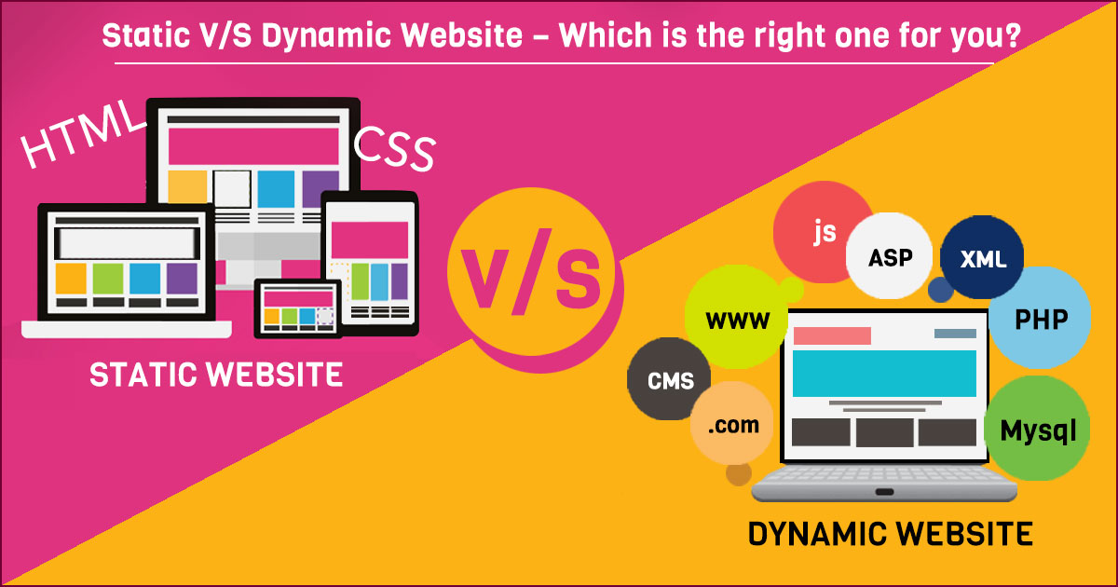

Slide 10
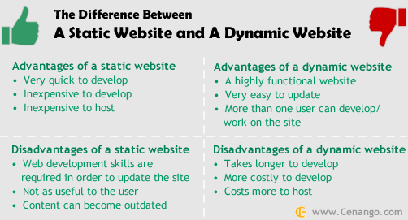

Slide 11
In a web development, involves:
  programming in software development
  web business
  web server and network administration
  hosting graphics and design
  the development and administration of DB
  construction of interfaces
  project management and quality assurance
  search engine optimization
  The maintenance of data in content management system

Slide 12
Programming for a web project may be accomplished using the following:
  one or more markup language (such as HTML or XML)
  scripting languages (e.g., Javascripts, Perl, PHP) or complex programming languages (e.g., programming C, C++, C# or Java).
When hosting a web project, the primary objectives include the provision of the necessary hardware and software infrastructure, and an assurance that the highest possible levels of availability and reliability are offered.

Slide 13
INTRODUCTION TO MOBILE APPLICATION

Slide 14

INTRODUCTION TO MOBILE DEVELOPMENT
Mobile Computing: associated with the mobility of hardware, data and software in computer applications.
Using mobile computing, user will be able to access data, information or other logical objects from any device in any network while on the move.
The user able to perform a task from anywhere using a computing devices
Notes:
Mobile computing is a concept closely tied to the idea of making computer resources and functionality accessible while on the move. It revolves around the mobility of hardware, data, and software in various computer applications.
Here's an explanation of mobile computing:
Mobile Computing: Mobile computing is a technological paradigm that revolves around the mobility of hardware, data, and software in the realm of computer applications. It fundamentally transforms the way we interact with and utilize computer resources, enabling users to access data, information, or other logical objects from virtually any device connected to a network, even while on the move.
Key Features of Mobile Computing:
Access from Anywhere: With mobile computing, users have the remarkable ability to access their data and perform tasks from anywhere, regardless of their physical location. This means you can connect to your computer systems, retrieve information, or execute commands whether you are at home, in the office, or on the go.
Device Agnosticism: Mobile computing isn't bound to a specific device. It's device-agnostic, meaning you can use a variety of computing devices, such as smartphones, tablets, laptops, or wearable devices, to access and manipulate data or run applications.
Network Connectivity: Mobile computing relies heavily on network connectivity. Users can tap into data and services stored on remote servers or in the cloud, making it possible to retrieve information and perform tasks over the internet or private networks.
Task Flexibility: One of the remarkable aspects of mobile computing is the flexibility it offers in performing tasks. You're not limited to a specific location or device, allowing you to work, communicate, or access information on your own terms.
Enhanced Productivity: By removing the constraints of fixed locations and devices, mobile computing enhances productivity. It enables individuals and organizations to work efficiently, collaborate seamlessly, and stay connected in an increasingly mobile world.
In essence, mobile computing empowers users with the freedom to stay connected, productive, and informed regardless of their physical location. It has become an integral part of our modern digital lifestyle, revolutionizing the way we live and work in an interconnected world.

Slide 15
DEFINITION
A simple definition could be:
Mobile computing is using a computer (of one kind or another) while on the move.
Another definition could be:
Mobile computing is when a (work) process is moved from a normal fixed position to a more dynamic position.
A third definition could be:
Mobile computing is when a work process is carried out somewhere where it was not previously possible
Notes:
Describing mobile computing using these three different definitions:
Mobile Computing as Portable Computer Usage:
- Mobile computing can be simplistically defined as the use of a computer, in various forms, while on the move. It encompasses the idea of harnessing computing power and accessing digital resources from devices like smartphones, tablets, or laptops, irrespective of your location.
Mobile Computing as Dynamic Work Process Relocation:
- Another perspective on mobile computing is the relocation of a work process from a traditional, fixed position to a more dynamic and flexible location. It involves adapting tasks and workflows to be performed on portable devices, allowing for greater mobility and adaptability in how work is accomplished.
Mobile Computing as Expanding Work Possibilities:
- From a broader standpoint, mobile computing can be seen as the expansion of work possibilities to locations where they were previously impractical or impossible. It opens up new avenues for conducting tasks and carrying out processes in places that were not traditionally equipped for such activities, thereby increasing efficiency and convenience.
These definitions provide varying levels of detail, making it easier to convey the concept of mobile computing to different audiences or for different purposes. The core idea in all three definitions is the utilization of computing technology in a mobile or flexible manner to enhance accessibility and productivity.

Slide 16
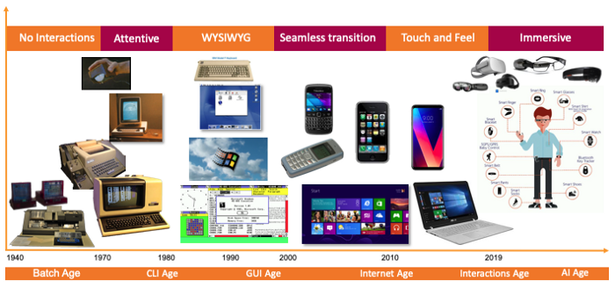
Notes:
The Evolution of Computer Interaction: A Journey Through Interface Paradigms
No Interaction:
In the earliest days of computing, there was virtually no interaction between humans and machines. Computers were large, room-filling devices operated by experts who fed them punch cards or toggled switches to execute specific tasks. Interaction was minimal and restricted to the technical domain.
Attentive Interaction:
The advent of text-based interfaces marked a significant step forward. Users could now interact with computers by typing commands or queries. This attentive interaction required users to have knowledge of specific commands and syntax, making computing accessible to a broader audience but still demanding attention to detail.
WYSIWYG (What You See Is What You Get):
The introduction of graphical user interfaces (GUIs) brought about a paradigm shift. WYSIWYG interfaces allowed users to interact with computers in a more intuitive and visually appealing way. Users could see on the screen exactly what they were working on, making word processing, design, and desktop computing more user-friendly.
Seamless Transaction:
The evolution continued with the concept of seamless transactions. With the growth of e-commerce and online services, users could interact with computers to conduct transactions, shop online, or manage financial accounts. This paradigm emphasized ease of use and secure, efficient interactions for tasks like online shopping and banking.
Touch and Feel:
The advent of touch interfaces, driven by smartphones and tablets, introduced a tactile dimension to computer interaction. Users could touch, swipe, and pinch on screens to navigate and manipulate digital content. This tactile experience made computing more intuitive and accessible, especially for mobile devices.
Immersive Interaction:
The latest frontier in computer interaction is immersion. Emerging technologies like virtual reality (VR) and augmented reality (AR) enable users to step inside digital worlds or overlay digital information onto the physical world. Immersive interactions engage multiple senses, creating an environment where users can fully immerse themselves in virtual experiences.

Slide 17
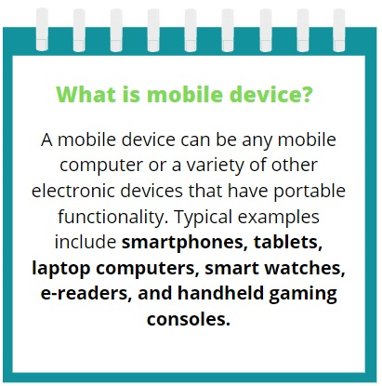
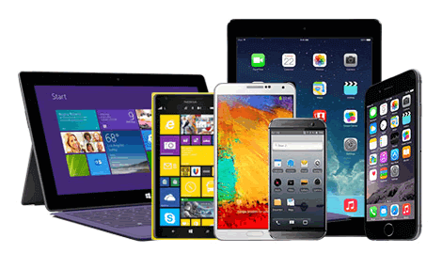

Slide 18
DIFFERENT NAMES IN DIFFERENT CONTEXTS
Many other names/overlapping computing paradigms:
  Pervasive Computing
  Ubiquitous Computing
  Nomadic Computing
  Internet of Things (IoT)
  Wireless Systems
  Embedded Computing
  Wireless Sensor Networks
  Mesh Networks
  ….

Slide 19
DIFFERENT NAMES IN DIFFERENT CONTEXTS
Pervasive computing is the growing trend of embedding computational capability into everyday objects to perform useful tasks.
It can occur with any device, at any time, in any place and in any data format across any network, including laptops, notebooks, smartphones, tablets, wearable devices, lighting systems, appliances and sensors, and so on.

Slide 20
DIFFERENT NAMES IN DIFFERENT CONTEXTS
Wearable Computer: can be worn by humans like a hat, shoe, or clothes.
Always on, operational while on the move, hands free, equips with sensors. Some are implanted in human body and integrated with human nervous system

Slide 21
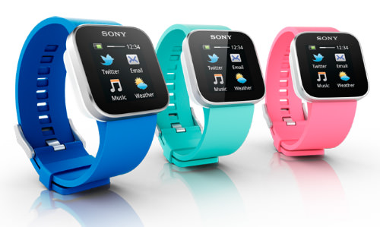
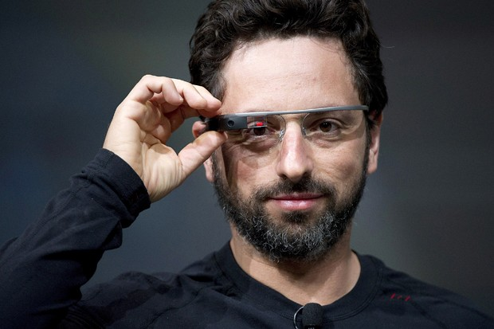
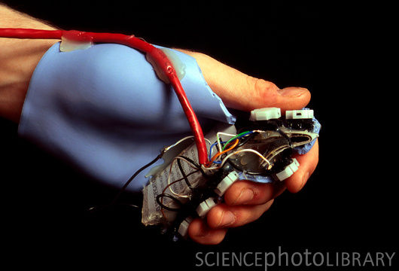
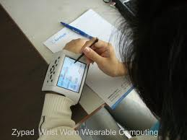
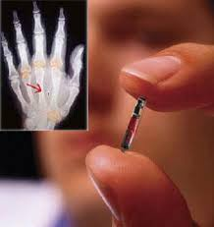
The wearable computers are used like wearable accessories like shoes, clothes etc.. by human beings. A person can wear it provided these computers have extra attributes than conventional mobile computers.

Slide 22
DIFFERENT NAMES IN DIFFERENT CONTEXTS
Ubiquitous computing: is a concept where computing is made to appear anytime and everywhere using small internet connected and inexpensive computers to help with everyday functions.
It focuses on learning by removing the complexity of computing and increases efficiency while using computing for different daily activities.
Ubiquitous computing is also known as pervasive computing, everyware and ambient intelligence.

Slide 23
DIFFERENT NAMES IN DIFFERENT CONTEXTS
Three types of ubiquitous system devices includes:
  Tabs: wearable centimeter-sized devices, e.g. smartphones, smart cards
  Pads: hand-held devices, laptops
  Boards: meter-sized interactive display devices, e.g. surface computer, smart boards.

Slide 24
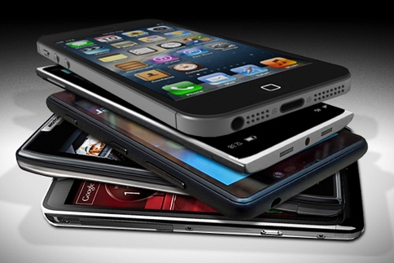
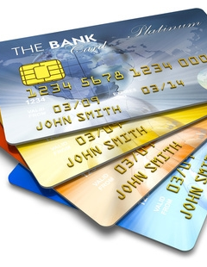
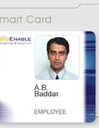
Tabs
Wearable centimeter-sized devices

Slide 25
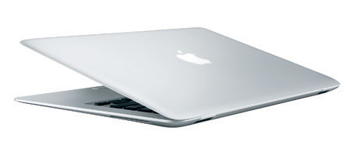
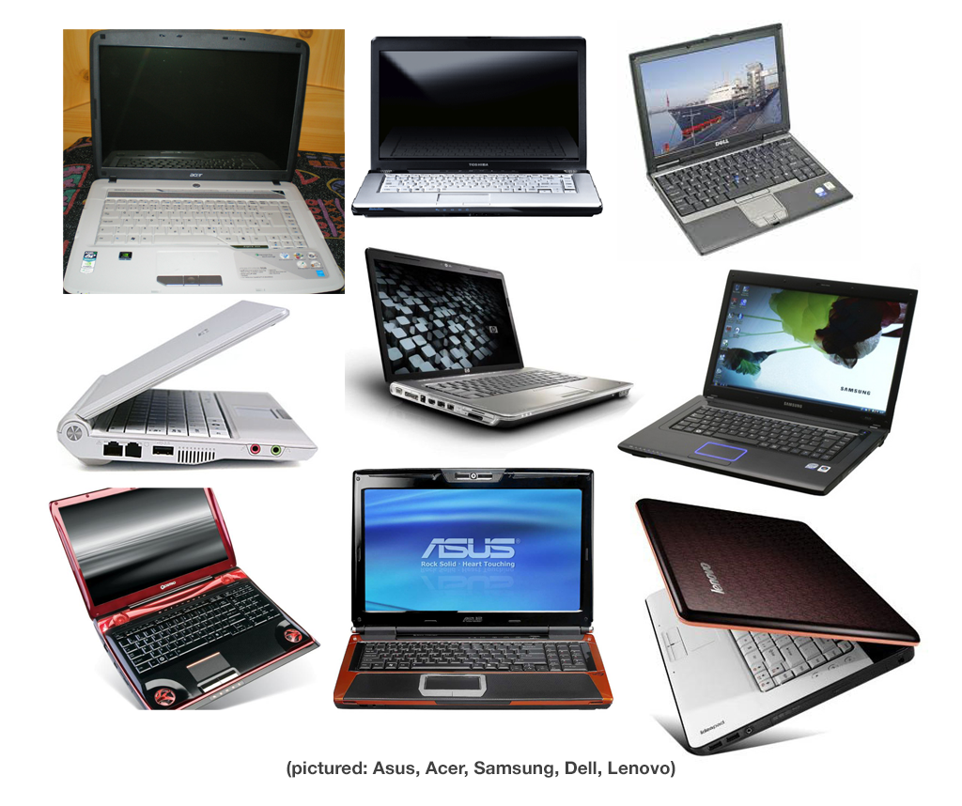
Pads: hand-held devices

Slide 26



Boards
meter-sized interactive display devices

Slide 27
DIFFERENT NAMES IN DIFFERENT CONTEXTS
Nomadic Computing: the computing environment is nomadic and moves along with the mobile user.
  A nomad refers to community of people who live in different locations, moving from one place to another
  The example of users carrying laptop with wireless access are engaged in nomadic computing

Slide 28
DIFFERENT NAMES IN DIFFERENT CONTEXTS
Internet of Things (IoTs): is an environment of humans, objects, or things, where everyone has assigned with a unique identity and has the ability to transfer the data over a network without any human to human and machine to human involvement.
Examples: connected security systems, thermostats, cars, electronic appliances, lights in household and commercial environments, alarm clocks, speaker systems, vending machines and more.

Slide 29
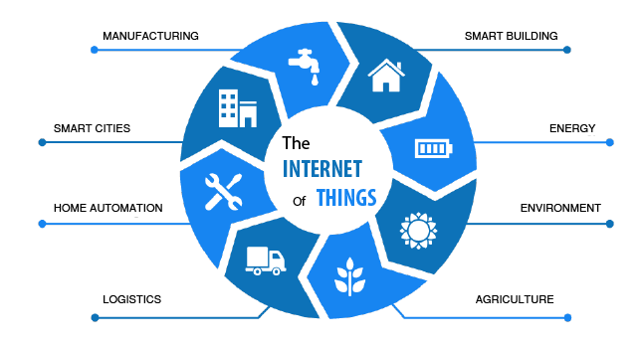
DIFFERENT NAMES IN DIFFERENT CONTEXTS

Slide 30
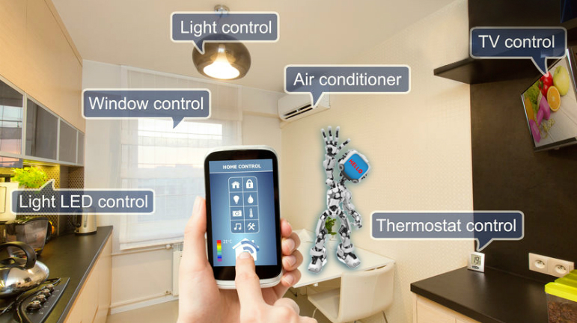
DIFFERENT NAMES IN DIFFERENT CONTEXTS
Home Automation

Slide 31

What problems are associated with mobile computers?
In wireless communication the surrounding environment interacts with the signal, blocking signal paths and introducing more noise than in wired networks. This results in that wireless networks are more likely affected by disconnection, have lower bandwidth.
Manufactures make hand-held, portable computers small and light so they are possible to carry around. Batteries are the largest single source to weight in a portable computer. Reducing battery weight reduces the power as well, and users have to recharge frequently, carry spare batteries, or use their mobile computers less.

Slide 32

Mobile Computing: issues
Continuous connectivity
How to stay connected when moving between networks or when external factors such as weather or environment interfere with signal reception, or nodes are removed?
Wireless communication without infrastructure
Different networks use different infrastructures and standards to structure its inhabitant devices. As an outsider enters, it might be hard to find, recognize and interact with other devices in the network.

Slide 33
Mobile Computing: issues
Location awareness
The range, cost and maintaining the connection is important. With and increased number of nodes, there will be a higher pressure on the network, causing negative effects on it’s bandwith.
Resource discovery
Resource constraints: Both mobile and devices in a smart space need to be small which makes battery time decrease.
Security
Privacy is a major issue for users who may distrust systems because of their sensing abilities. Users might not always be aware of being sensed.

Slide 34
Different Types of Mobile Application
  Native mobile apps
  Cross-platform apps
  Hybrid apps
  Web apps

Slide 35
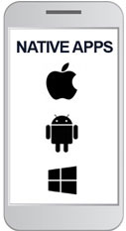
Native Mobile Apps
Native mobile apps are written in a language that’s natively supported by the device OS vendor
– iOS / Android
They use the development tools and
language that the respective platform
supports (Android – Java/Kotlin,
iOS – Swift/Objective-C).
Notes:
Native mobile apps are applications that are developed specifically for a particular mobile operating system, such as iOS or Android. These apps are written in programming languages that are natively supported by the device's OS vendor, and they utilize the development tools and libraries provided by the respective platform. Here's a closer look at native mobile app development for iOS and Android:
iOS (Apple):
Languages: Native iOS apps are primarily written in either Swift or Objective-C.
Swift: This is Apple's modern and preferred programming language for iOS app development. It's known for its readability, performance, and safety features.
Objective-C: While less commonly used today, it was the primary language for iOS development before Swift was introduced.
Development Tools: Developers use Xcode as the Integrated Development Environment (IDE) for iOS app development. Xcode provides a comprehensive suite of tools for coding, debugging, and designing user interfaces.
Interface Design: Interface design for iOS apps is typically done using UIKit for traditional app layouts and SwiftUI for more modern and declarative UI development.
Android (Google):
Languages: Native Android apps can be written in Java or Kotlin.
Java: Historically, Java was the primary language for Android app development. It's still widely used in legacy applications.
Kotlin: Kotlin is now the preferred language for Android development due to its conciseness, safety features, and interoperability with Java.
Development Tools: For Android app development, developers use Android Studio, which is the official IDE provided by Google. Android Studio offers powerful tools for coding, debugging, and testing Android apps.
Interface Design: Android uses the Android UI Toolkit, which includes components like Activities, Fragments, and XML layouts to design user interfaces. The design can also be enhanced with tools like Jetpack Compose for modern UI development.
The key advantages of native mobile app development are:
Performance: Native apps are optimized for their respective platforms, resulting in faster and more efficient performance.
Access to Device Features: Native apps have direct access to device hardware and features, allowing for more extensive integration.
Platform-Specific Design: Developers can create user interfaces that follow the platform's design guidelines, ensuring a consistent and familiar user experience.
App Store Optimization: Native apps can take full advantage of app store features, such as in-app purchases, reviews, and notifications.
However, it's important to note that developing native apps for both iOS and Android can be more time-consuming and resource-intensive compared to cross-platform or hybrid app development approaches. Developers often choose between native and cross-platform development based on project requirements, target audience, and development team expertise.

Slide 36
Native Mobile Apps
Native apps acquire all possible advantages of the device and the operating system’s features.
The apps leverage direct access to the hardware of the devices such as GPS, camera, microphone, contacts, offline access, sensors, and many more.
Native apps boast of fast performance and a high degree of reliability for great user experience.
Notes:
Native apps indeed offer several advantages due to their direct integration with the device's operating system and hardware features. Here's a closer look at the key advantages of native apps in this context:
1. Full Access to Device Features:
GPS: Native apps can access precise location information, enabling location-based services like maps, geofencing, and navigation.
Camera: They can utilize the device's camera for features like taking photos, recording videos, or enabling augmented reality experiences.
Microphone: Native apps can access the microphone for voice recording, voice commands, or audio processing.
Contacts: They have access to the device's contact list for features like importing, syncing, or sharing contacts.
Offline Access: Native apps can store data locally, allowing users to access content and features even when they are offline.
Sensors: They can tap into various sensors like accelerometers, gyroscopes, and ambient light sensors for innovative functionalities.
Notifications: Native apps can use the device's notification system for timely alerts and updates.
2. Performance:
Native apps are optimized for their respective platforms and take full advantage of platform-specific coding languages, libraries, and tools. This optimization results in faster execution and smoother user interactions.
They are compiled directly into machine code, which eliminates the need for an intermediate layer, improving overall performance.
3. Reliability:
Native apps are known for their reliability and stability. Since they are designed specifically for a particular operating system, they are less likely to experience compatibility issues or crashes.
Developers have access to platform-specific debugging tools and resources, making it easier to identify and fix issues quickly.
4. Consistent User Experience:
Native apps adhere to the design guidelines and user interface conventions of the respective platforms (iOS or Android). This ensures a consistent and intuitive user experience.
Users feel familiar with the app's navigation and layout, enhancing usability.
5. Security:
Native apps can implement robust security measures, including encryption and authentication, to protect sensitive user data.
They can leverage platform-specific security features and updates to stay ahead of emerging threats.
6. App Store Optimization:
Native apps can fully utilize the features provided by app stores, such as user reviews, ratings, in-app purchases, and push notifications, to enhance user engagement and monetization.
However, it's important to note that native app development typically requires separate development efforts for each platform (iOS and Android) and may involve a longer development timeline and higher development costs compared to cross-platform or hybrid approaches. Developers need platform-specific expertise to build and maintain native apps effectively. The choice between native and other development methods depends on project goals, budget, and the need for specific device features and performance.

Slide 37
Native Mobile Apps
However, native apps are expensive to develop as they are designed for only one type of OS.
To run the app on multiple platforms, it requires developing and maintain an app for each platform separately.
But native apps are a future-proof investment. They are secured, user-friendly, and faster than other apps.
Notes:
If the business obliges to serve the audience well, we should go with Native app development.

Slide 38
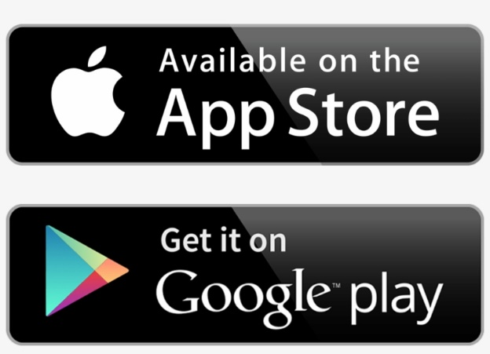
Native Mobile Apps
Advantages:
  Natives are very fast.
  Easily distributed in Google and Apple app stores.
  More interactive and intuitive.
  Easily interact with any feature of the phone.
  Lesser compatibility issues and faster to configure.

Slide 39
Native Mobile Apps
Disadvantages:
  Built for a single platform – time consuming
  Hard to learn the language to build the apps – Swift or Java
  Requires separate codebase to add new features.
  Expensive to develop and hard to maintain.

Slide 40
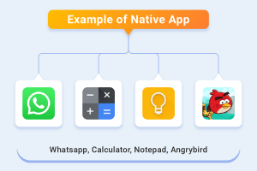
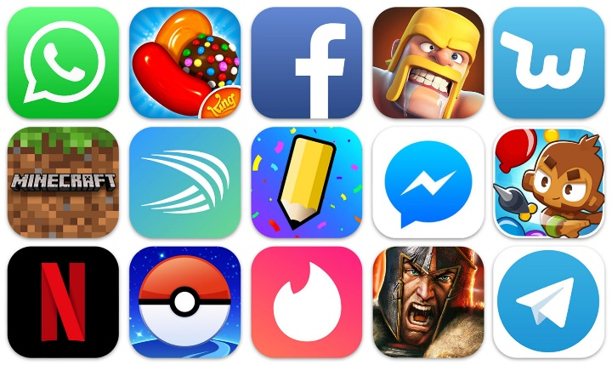

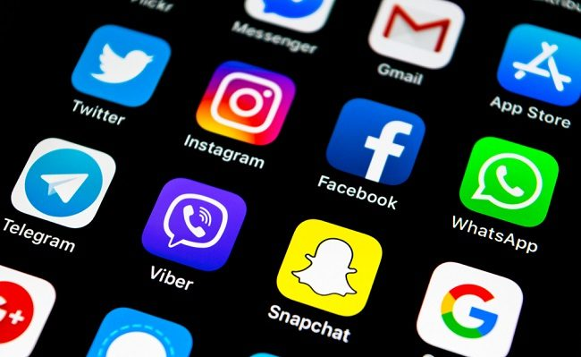
Native Mobile Apps
Example of apps:
  Google Map, WhatsApp, Facebook, Netflix, Gmail, YouTube, Twitter, almost all games, and any pre-set apps

Slide 41

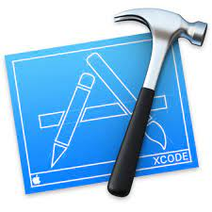
Native Mobile Apps
Tools to develop:
  iOS – XCode, App Code, Atom
  Android - Android Studio, Android IDE, IntelliJ IDEA

Slide 42

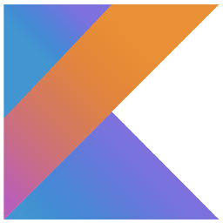
Native Mobile Apps
Programming languages for Android native apps:
Java
One of the most popular and preferred
languages among Android app developers.
Kotlin
Kotlin is a new object-oriented first-class
programming language like Java.
It is comparatively clean and has multiple
advanced features - supports almost all the
IDEs including Android Studio and SDK toolkit.

Slide 43


Native Mobile Apps
Programming languages for iOS native apps:
Swift
Swift is the latest and primary language used in the
development of iOS and OS X, thus
replacing Objective-C to an extent.
Objective-C
A derivative of the programming language C
It is the core programming language to
develop iOS and OS X before Swift, but
has still maintained its popularity among developers.

Slide 44
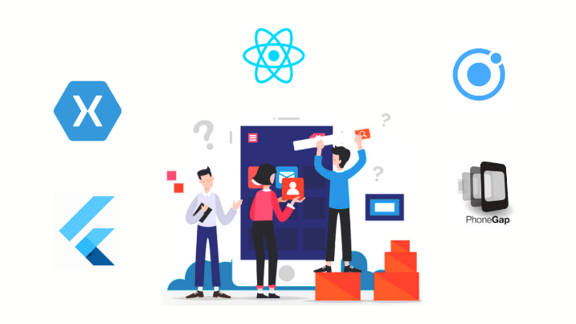
Cross-platform Apps Development
Cross-platform mobile application development is the process of developing an application with a single code base to run on multiple mobile platforms.
Like native apps, they live in an application store and can take advantage of many device features.
Notes:
Cross-platform mobile application development is an approach to creating mobile apps that allows developers to write a single codebase that can run on multiple mobile platforms, such as iOS, Android, and sometimes even other platforms like Windows or web browsers. This approach is designed to streamline development, reduce costs, and reach a broader audience with a consistent user experience. Here are key aspects of cross-platform mobile application development:
1. Single Codebase:
Developers write and maintain one set of code using languages like JavaScript, TypeScript, or Dart (for frameworks like React Native, Flutter, or Xamarin).
This code is then compiled or translated to native code for each target platform, allowing the app to function on different operating systems.
2. Frameworks and Tools:
Cross-platform development is facilitated by frameworks and tools that abstract away platform-specific differences and provide a unified development environment.
Popular cross-platform frameworks include React Native, Flutter, Xamarin, and Apache Cordova (PhoneGap).
3. Access to Device Features:
Cross-platform apps aim to provide access to many device features, similar to native apps. This is achieved through plugins or modules that bridge the gap between the cross-platform codebase and native APIs.
Developers can access features like GPS, camera, accelerometer, and more, although there may be some limitations or delays in adopting new features.
4. User Experience:
Cross-platform apps strive to offer a native-like user experience by adhering to the design guidelines of each platform. This helps ensure that the app looks and behaves appropriately on iOS and Android.
Frameworks like Flutter emphasize pixel-perfect design and smooth animations to achieve this goal.
5. App Stores:
Cross-platform apps can be published in app stores, such as the Apple App Store and Google Play Store, just like native apps. Users can discover and install them in the same way.
6. Performance:
While cross-platform frameworks have made significant strides in improving performance, native apps may still have a slight edge in terms of raw speed and efficiency, especially for graphics-intensive applications.
7. Code Reusability:
One of the primary benefits of cross-platform development is code reusability. Developers can reuse a significant portion of their codebase for different platforms, reducing development time and effort.
8. Cost Savings:
Cross-platform development can be cost-effective, as it requires fewer resources than building separate native apps for each platform.
9. Rapid Development:
Cross-platform frameworks often offer hot-reloading and other developer-friendly features, enabling rapid development and testing cycles.
10. Maintenance:
Maintaining a single codebase for multiple platforms can simplify app updates and bug fixes, as changes are applied uniformly across all platforms.
In summary, cross-platform mobile application development offers a practical way to create mobile apps for multiple platforms while maximizing code reuse and minimizing development time and costs. However, the choice between cross-platform and native development depends on factors like the specific project requirements, performance considerations, and the development team's expertise.

Slide 45
Cross-platform Apps Development
It is the best approach for low-cost custom apps with secure, stable, and easy to maintain and iterate features.
Many cross-platform app development frameworks help to achieve the native app-like feel and user experience.
If the company has a limited budget, but it requires a satisfactory app performance, so cross-platform is an ideal approach.

Slide 46
Cross-platform Apps Development
There is a wide range of cross-platform mobile app development technologies available that makes it easy for developers to conceptualize, develop, and launch a beautiful and functional application on multiple platforms simultaneously.
Some of the most popular cross-platform mobile technologies include Flutter, React Native, Xamarin, Ionic, etc.

Slide 47
Cross-platform Apps Development
Advantages:
  Easy to build
  Much cheaper than a native app
  Single app for all platforms
  Able to access device features/utilities via API
  Faster to develop than native apps – quicker development time

Slide 48
Cross-platform Apps Development
Disadvantages:
  Poor performance - slower than native apps
  Limited access to features
  Issue in frequent updates
  Less interactive than native apps
  Rendering time takes longer

Slide 49
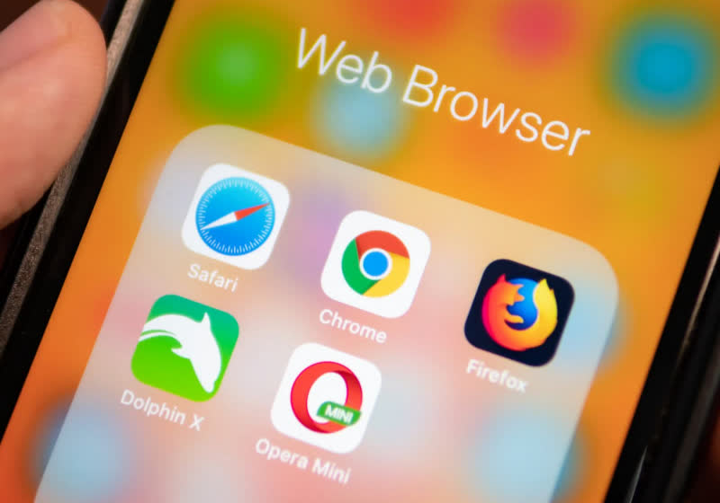
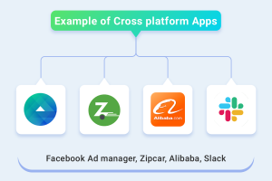
Cross-platform Apps Development
Example of apps:
  Firefox, Chrome, OpenOffice, Adobe Reader, etc.

Slide 50

Cross-platform Apps Development
React Native
React Native is an open-source mobile app development platform created by Facebook.
The process of layout creation works the same way for mobile screens and web page layout.
Interaction of components with each other is flexible and easy.

Slide 51

Cross-platform Apps Development
Xamarin
Xamarin is Microsoft's mobile app development platform to create Windows, iOS, and Android apps using a single .NET code.
Xamarin uses a single language, C#, which enables developers to give their apps a native look and feel.
Almost all elements of this simple tool are 100% compatible with any platform.

Slide 52

Cross-platform Apps Development
Flutter
This open-source framework was created by Google.
Flutter capable to deliver high performance across iOS, Android, Windows, macOS, and the Web using a single codebase.
It has a Hot Reloading feature and a large set of ready-made widgets.
Compatible with different IDE’s including Android Studio (IntelliJ) and VS Code

Slide 53
Hybrid Apps Development
A hybrid app is a type of application that combines elements of both native apps and web apps.
It is built using web technologies like HTML, CSS, and JavaScript but is packaged inside a native app wrapper, allowing it to be installed and run on a mobile device just like a native app.
Tools like Apache Cordova and Ionic are commonly used to create this native wrapper

Slide 54
Hybrid Apps Development
Hybrid apps are an attractive option for developers because they can use a single codebase to create apps that work across multiple platforms, such as iOS and Android.
This saves time and resources compared to building separate native apps for each platform.
The app is essentially a web app running inside a native app shell.

Slide 55
Hybrid Apps Development
Hybrid apps can access certain native device features such as the camera, GPS, push notifications, and more through plugins that act as a bridge between the web technologies and the device’s native APIs.
Offline Support - like native apps, hybrid apps can have offline capabilities, allowing them to store data locally and operate without an internet connection for certain tasks.

Slide 56
Hybrid Apps Development
Several frameworks are available to build hybrid apps:
  Apache Cordova: One of the most popular frameworks for hybrid app development, it enables web developers to wrap their code in a native container to access native device features.
  Ionic: Built on top of Apache Cordova, Ionic provides a rich set of UI components and tools that make it easier to build hybrid apps with a more native-like user experience.
  Framework7: Another popular hybrid app framework, it provides native-style UI components and layouts for iOS and Android.

Slide 57
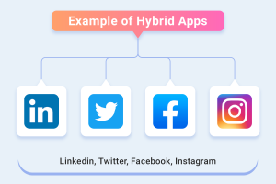
Hybrid Apps Development
Example of apps: Instagram, Twitter, Uber, etc.

Slide 58
Hybrid Apps Development
When to choose hybrid apps development? If…
  there are limited time and resources and need to deploy across multiple platforms quickly.
  the app does not require extensive native interactions, such as 3D graphics, advanced animations, or other highly performance-dependent features.
  leverage existing web development expertise to create mobile apps.

Slide 59
Web Apps Development
Web apps are a lightweight paradigm where you open a URL in your device’s browser, but they look and feel like a regular mobile app. These apps do not require to install on mobile devices and were run on web-hosted servers.
Mobile web apps typically use HTML, CSS, Javascript, JQuery web technologies.
They cannot access all features of native device functionality (camera, calendar, geolocation, etc.).

Slide 60
Web Apps Development
Adaptive web apps scale to fit the different screen sizes of mobile devices.
Web apps are built using the most popular programming languages, but they can’t use hardware on mobile devices or be sold in any app stores.

Slide 61
Web Apps Development
Developers can use two website programming paradigms to create mobile web apps:
  Responsive web programming is a style of web site programming where the web site layout organizes itself to suit the device’s form factor.
  Instead of having to browse horizontally, the content snaps in place to fit the width of the device. These web sites can also be used from a desktop

Slide 62
Web Apps Development
  Progressive web application (PWA) are normal websites that appear like a traditional mobile app when navigated to from a browser on a mobile device.
  They deliver an almost app-like experience. It has an ability to add a link to the Home screen (so that you get an app icon), and they are also able to run offline when not connected to the internet by caching the content locally on the device.

Slide 63
Web Apps Development
Advantages:
  Reduced business cost.
  No installation needed.
  Better reach as it can be accessed from anywhere.
  Always up-to-date.

Slide 64
Web Apps Development
Disadvantages:
  Dependent on internet speed.
  Interface not that sophisticated.
  Complex features can’t be used
  Take a longer time to develop.
  Security risk.

Slide 65
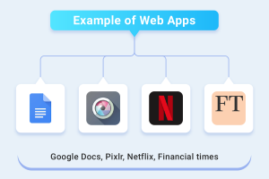
Web Apps Development
Example of apps: Microsoft Office Online, Zoom, Dropbox, Wordpress, etc.

Slide 66
Choosing the best programming language for mobile app development
When considering the programming languages, frameworks, and SDKs for mobile apps, need to consider the frontend (UI) development environment but also be aware of the backend (server-side) development environment.

Slide 67
Considerations when Developing AN Apps
When it comes to developing mobile applications, we must consider the unique features and capabilities of the platform.
Also, developer must cater to the different technical specifications of the devices e.g., different screen sizes, different touch-screen gestures, varying levels of performance power, and different requirements that apply to the Google Play and iOS App Store.

